Slide 1
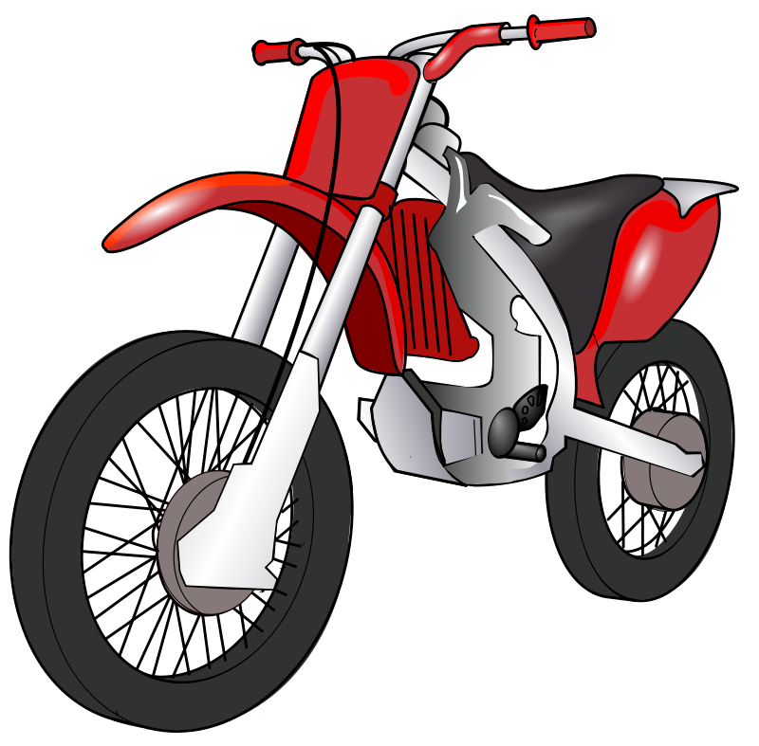
MotoRush
Presented By
MD. Rakibul Hasan MD. Mehedi Hasan
Reg No:2017831005 Reg No: 2017831023

Slide 2
This game is a team project. We have used SFML library and C++ to develop this game.
We have also used github to participate equally as a group project.
Photoshop and some other tools are also used to edit the textures and
Images, musics(mp3,ogg).
Textures, Images and musics are collected from internet and edited as
They need.

Slide 3
MotoRush is a racing game.The player has to move the bike without making any collision with any other vehicles.
Following slides contain the game screenshots.Lets see.

Slide 4
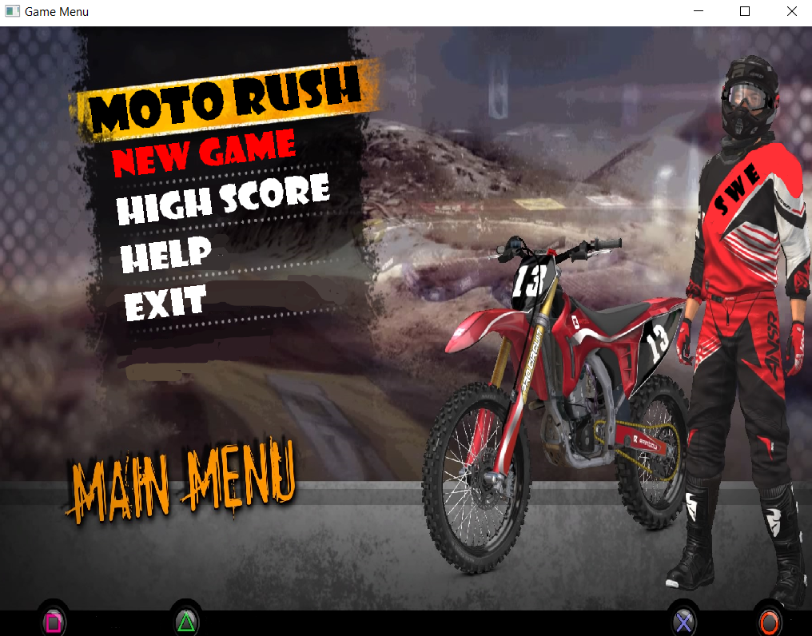

Slide 5
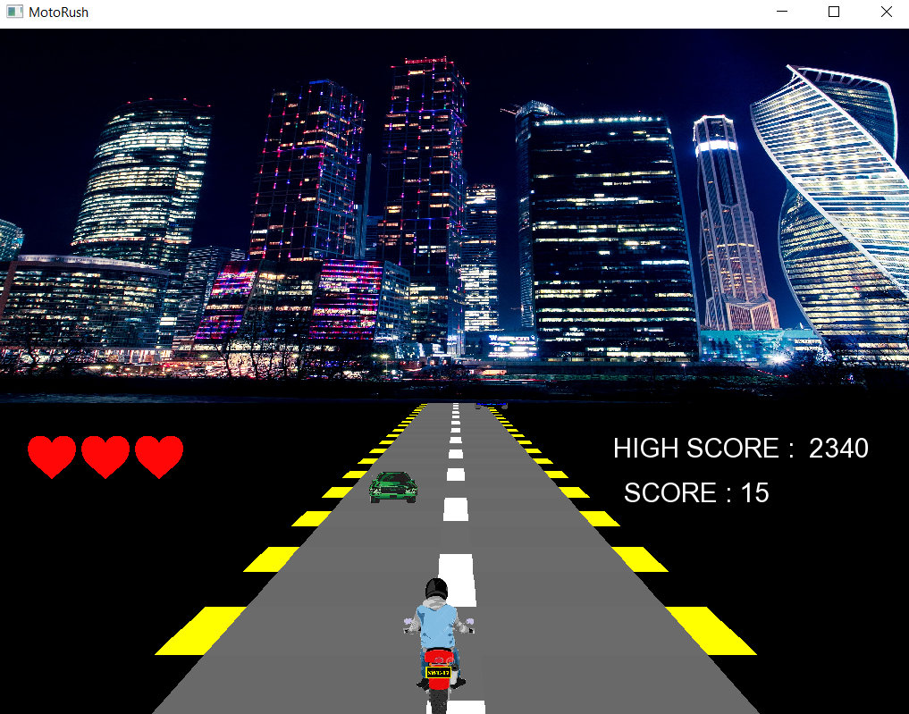

Slide 6
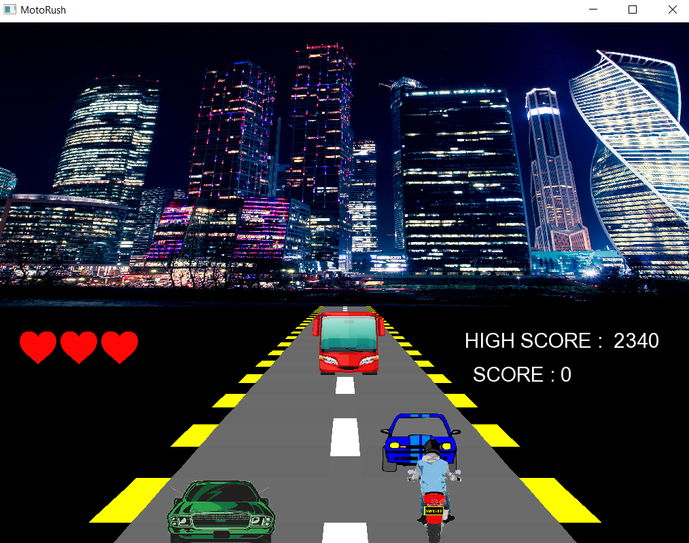

Slide 7
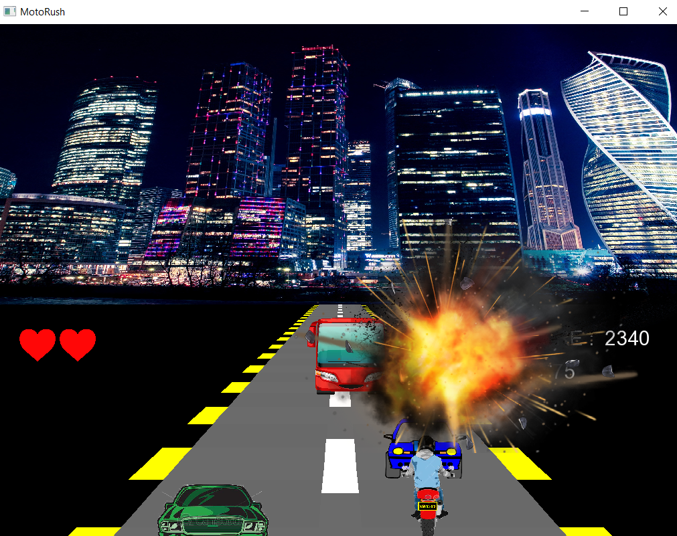

Slide 8
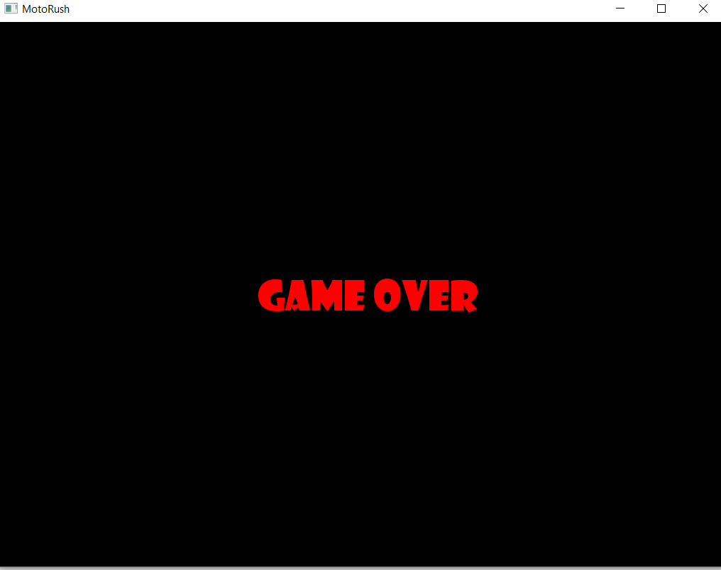

Slide 9
Thank You

